Slide 1
result_11092014\2497Cp9 DMSOa
original
feature group analyzed

Slide 2
result_11092014\2497Cp9 _TC1253a
original
feature group analyzed

Slide 3
result_11092014\BJ2Ap10 DMSOd
original
feature group analyzed

Slide 4
1092014\BJ2Ap10 TC1253b
original
feature group analyzed

Slide 5
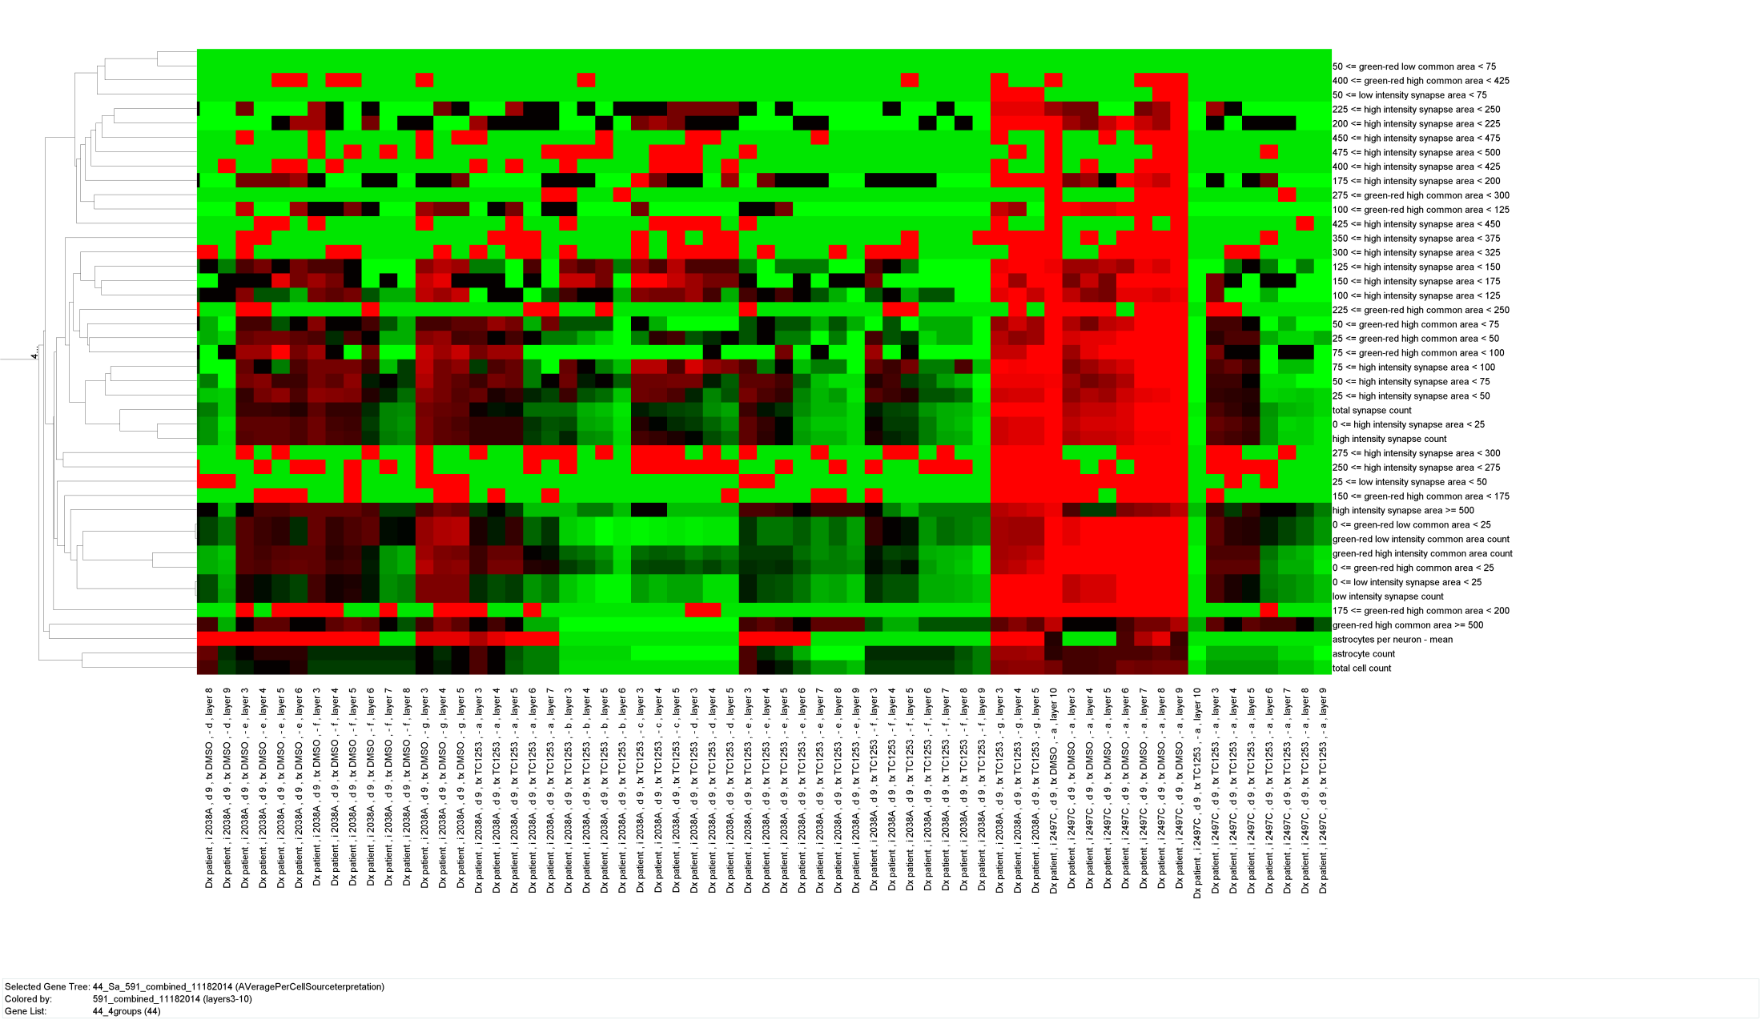
Image Analysis Feature Heatmap
Each layer shown, zoom view

Slide 6
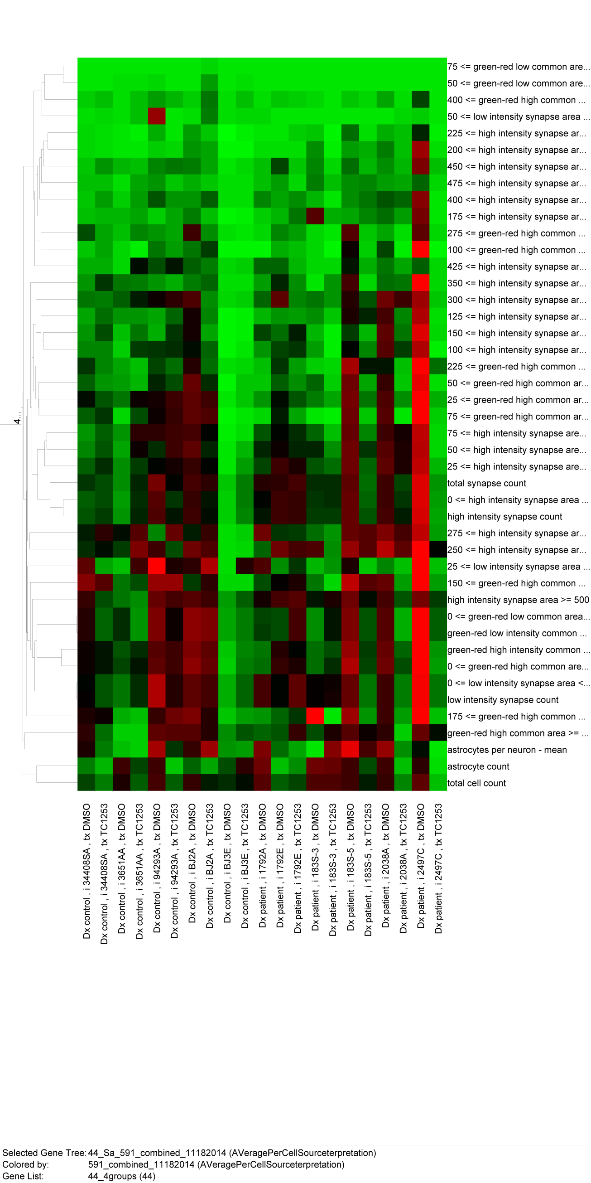

Slide 7
Normalized Image Analysis Features: whisker plot per cell X treatment
100
100
3 of the patient cell lines show highly significant normalizing effects by TC1253
10
10
1
1
0.1
0.1
DMSO
TC1253
DMSO
TC1253
DMSO
TC1253
DMSO
TC1253
DMSO
TC1253
DMSO
DMSO
TC1253
DMSO
TC1253
DMSO
TC1253
DMSO
TC1253
DMSO
TC1253
tx
0.01
tx
0.01
control 34408SA
control 3651AA
control 94293A
control BJ2A
control BJ3E
patient 1792A
patient 1792E
patient 183S-3
patient 183S-5
patient 2038A
patient 2497C

